Slide 1



DATA ANALYSIS
ON LAPTOP PRICES
Speaker name: Kira Wong

Slide 2

OBJECTIVE
Predict laptop prices base on a given specs
Have you ever wanted to purchase an upcoming laptop model but not know the price?

Slide 3








METHODLOGY
Web scrape
EDA
OLS model

Slide 4
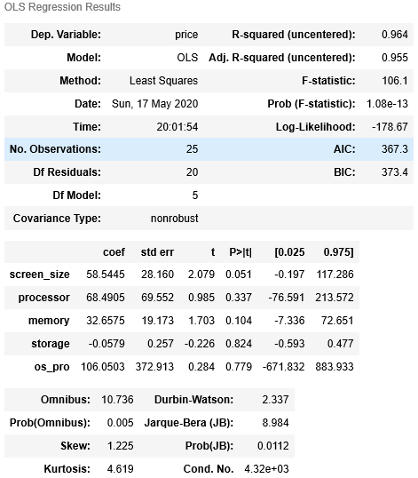
RESULTS
R- squared: 0.964
Skew: 1.255
Kurtosis: 4.619

Slide 5
INSIGHTS
CONCLUSION
Laptop prices have a non-linear relationship with higher specs
Linear regression may not be a suitable model since numerical features are discrete in nature (only able to verify after testing with more data)

Slide 6
FUTURE WORK
Add more parameters ( e.g weight, brand)
Include datasets from other re-seller (e.g Gain City, Harvey Norman, Best Denki)
Use a classification model

Slide 7

Thanks!
Any questions?
You can find me at:
stormseekerx@hotmail.com

Slide 8
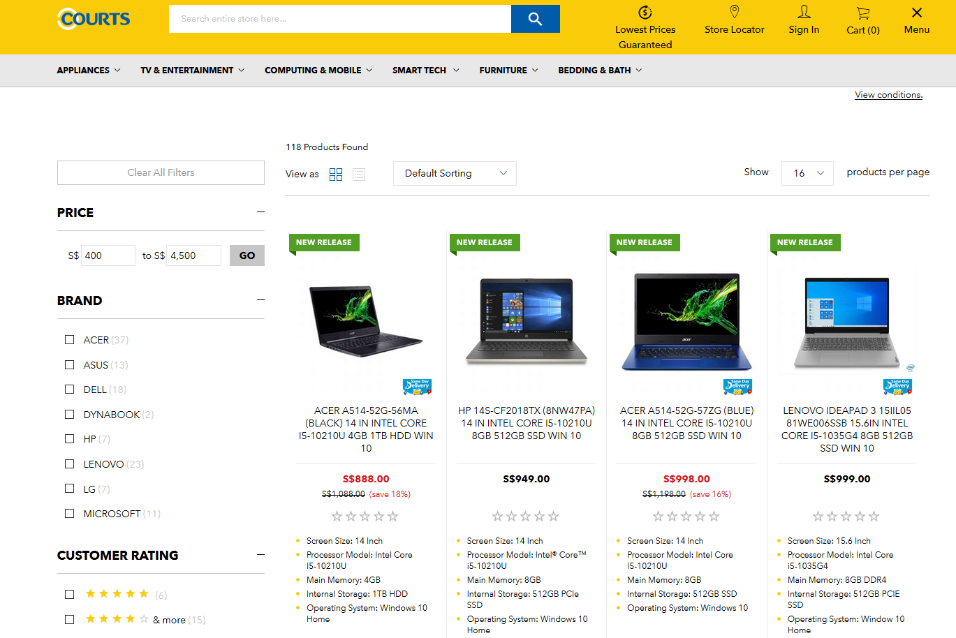

Slide 9
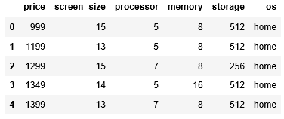
DATASET

Slide 10
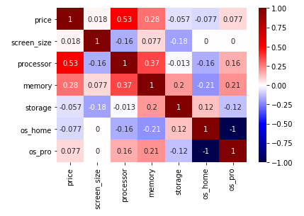
FEATURE SELECTION

